Slide 1
Project Name: Online Shopping Cart
Name: Naimul Islam Nobel
Id: 143-35-775

Slide 2
Project Module:
1. Registration System
2. Shopping Cart
3. Confirming Order by payment.

Slide 3
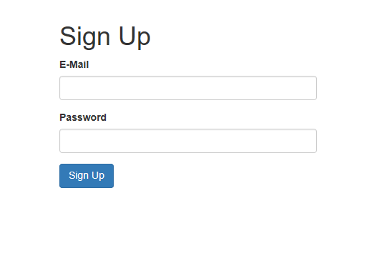
Registration/Signup:

Slide 4
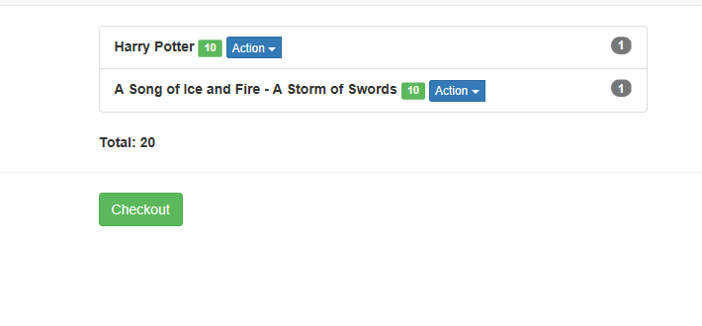
Shopping Cart:

Slide 5
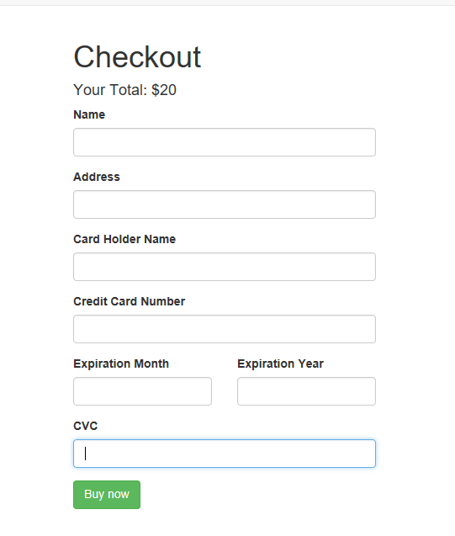
Payment:

